Slide 1
OBJECT ORIENTED
ANALYSIS AND DESIGN
Ch - 8
Finding analysis classes
A study material for the students of GLS University

Slide 2
UP Activity – Analyze a Use Case
The UP activity Analyze a Use Case produces two important outputs:
1. Analysis Classes
Classes that represent important concepts in the problem domain.
2. Use Case Realizations
Collaborations between objects that show how interacting objects realize the behavior expressed in a use case.

Slide 3
What is the Problem Domain?
The problem domain is the area in which the need for a software system arises.
Examples:
Online selling
Customer relationship management
Banking
Hotel reservation
Airline reservation
The problem domain can also arise from physical hardware that requires software, as in an embedded system.

Slide 4
What is an Analysis Class?
An analysis class represents a crisp abstraction in the problem domain.
It should:
Represent an important concept of the problem domain
Map clearly to a real-world business concept
Have a meaningful and appropriate name
Represent one specific aspect of the problem domain
Examples
Customer
Product
Account
ShoppingBasket
Order
These represent identifiable concepts within their respective problem domains.

Slide 5
Analysis Class and Problem Domain
Consider an E-Commerce System.
Problem Domain - Online Selling
Important Concepts -
Customer
Product
ShoppingBasket
Order
These concepts can become analysis classes because they represent identifiable elements of the problem domain.

Slide 6
Analysis Classes
Analysis focuses on the aspects of real-world things that are important from the perspective of the system.
For example, in a banking system, a customer may have many characteristics.
Relevant:
Name
Address
Account information
Irrelevant to the banking system:
Preference for window or aisle seats on an aircraft
Therefore, only the information relevant to the system is modeled.

Slide 7
Analysis Class vs Design Class
Analysis Class -
Focuses on: What is important in the problem domain?
Contains:
High-level attributes,
High-level operations/responsibilities
Design Class -
Focuses on: How will the concept be implemented?
May contain:
Detailed attributes
Data types
Visibility
Method parameters
Return types
Implementation details
Problem Domain => Analysis Class => Design Class => Implementation

Slide 8
Anatomy of an Analysis Class
An analysis class contains a limited set of UML information.
Main elements -
Name
Attributes
Operations
Additional elements may be included when useful:
Visibility
Stereotypes
Tagged values

Slide 9
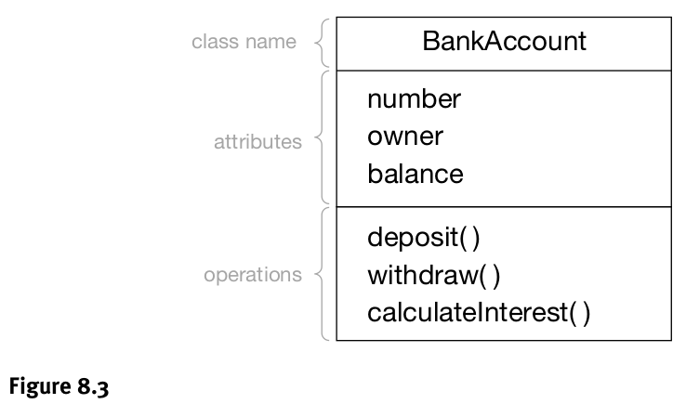
BankAccount – Analysis Class

Slide 10
What Makes a Good Analysis Class?
A good analysis class should:
Have a clear, meaningful name.
Model one specific real-world concept.
Map to an identifiable business feature (e.g., Customer, ShoppingBasket).
Have a small, focused set of responsibilities (3–5).
Show high cohesion – all responsibilities serve one goal.
Have low coupling – not overly dependent on too many other classes.
Example:
ShoppingBasket → responsibilities: add item, remove item, show items.
(Cohesive → all about maintaining basket).
Wrong responsibilities for ShoppingBasket: validate credit card, print receipt (should go to other classes).

Slide 11
Rules of Thumb for Analysis Classes
Keep it simple:
Each class should have 3 to 5 clear responsibilities (things it does).
This keeps the class easy to understand and use.
Classes should work together:
No class should exist alone.
Every class should collaborate (work) with other classes to perform tasks.
Avoid too many small classes:
If a class does only 1 or 2 small things, combine it with another related class.
Avoid very large classes:
If a class has too many tasks, it becomes confusing.
Split it into smaller, more focused classes.

Slide 12
Rules of Thumb for Analysis Classes
Avoid fake or meaningless classes:
These are fake classes with only one method (like doIt() or process()), which just run code instead of modeling real-world things.
They are not true objects.
Avoid “God classes”:
These are classes that try to do everything (like one big “System” or “Controller” class).
They make the design messy and hard to manage.
Instead, divide the work among smaller, specific classes.
Keep inheritance simple:
Don’t make long chains of parent–child classes.
Use inheritance only when there is a real “is-a” relationship (like Dog is a type of Animal).
This keeps your class hierarchy meaningful and easy to follow.

Slide 13
Finding Classes
There is no single algorithm that always identifies the correct analysis classes.
Three important approaches are:
1. Noun/Verb Analysis
Analyze relevant text.
2. CRC Analysis
Use collaborative brainstorming.
3. Other Sources
Look at physical objects, paperwork, interfaces and conceptual entities.

Slide 14
Noun/Verb Analysis
A text-based technique to identify candidate classes, attributes, and responsibilities.
Rule of thumb:
Nouns / noun phrases → possible classes or attributes.
Verbs / verb phrases → possible responsibilities (operations).
Works well because it uses the language of the problem domain.
Challenges:
Synonyms (different words, same meaning) & homonyms (same word, different meaning).
Hidden classes: important abstractions that are not explicitly mentioned.
Example: In a holiday reservation system, “Order” may be missing but is crucial.

Slide 15
Noun/Verb Analysis
Procedure -
Collect relevant information
↓
Identify nouns and noun phrases
↓
Identify verbs and verb phrases
↓
Clarify unknown terms
↓
Resolve synonyms and homonyms
↓
Create candidate classes, attributes and responsibilities
↓
Allocate attributes and responsibilities to classes
↓
Identify candidate relationships
↓
Create first-cut class model

Slide 16
CRC Analysis (Class, Responsibilities, Collaborators)
CRC is a brainstorming technique for identifying important concepts in the problem domain.
CRC uses sticky notes containing three sections:
Class name (top)
Responsibilities (left side)
Collaborators (right side → other classes it works with)
Example -
BankAccount
─────────────
Responsibility: Maintain balance
──────────────
Collaborator: Bank

Slide 17
CRC
CRC Procedure
Phase 1: Brainstorm (Gather Info)
Participants: OO analysts + stakeholders + domain experts.
Rules:
All ideas are accepted (no arguments, just record everything).
Steps:
Ask team to name business “things” (e.g., Customer, Product). → Write on sticky notes.
Note down responsibilities on the sticky notes.
Identify collaborating classes (draw connections or note them).

Slide 18
CRC
Phase 2: Analyze (Refine Info)
Participants: OO analysts + domain experts.
Decide which notes should be:
Classes (key business concepts, independent entities).
Attributes (parts of another class).
Rule: If not sure → treat it as a class (can refine later).

Slide 19
Other Sources of Classes
Beyond text analysis, look at:
Physical objects – e.g., Aircraft, Hotel, Person.
Paperwork – e.g., Invoice, Order, Bankbook.
Be careful → don’t just copy outdated or unnecessary processes.
Interfaces – e.g., Screens, Keyboards, External systems.
Conceptual entities – important but abstract ideas.
Example: LoyaltyProgram (not physical, but essential to model).

Slide 20
THANK YOU

